Slide 1
Predictive Maintenance AI/ML Models Results
Reliability Engineering | Artem Moshnin

Slide 2
Regression Model
This Regression Model is formulated in such a way that: Our goal is to predict the time until the next alert (LOW, MEDIUM, HIGH, or SIGMA) on the HTOL machines. As the training data, we’re using the alerts we have labelled automatically using the Alerting Dashboard previously.
How the Model Works:
Data Preparation: We gather data from all your HTOL machines and process it to extract meaningful information. This includes:
Time-based features: Hour of the day, day of the week, month, etc., as alerts might be more frequent at certain times.
Rolling statistics: We look at recent trends in Chiller Pressure (ChlPrs) by calculating its moving average and standard deviation. This helps us capture short-term fluctuations that might lead to an alert.
Time since last alert: We track how long it's been since the last alert of each type. This helps us understand the typical interval between alerts.

Slide 3
Regression Model
How the Model Works:
Model Training: We use a machine learning algorithm called a Random Forest Regressor.
This algorithm learns the relationships between the features we engineered (time-based features, rolling statistics, etc.) and the actual time until the next alert.
It's like showing the model many examples of past alerts and their preceding conditions so it can learn to recognize patterns.
Prediction: Once the model is trained, we can feed it the current data from your machines. The model then predicts how many days are left until the next alert of each type (LOW, MEDIUM, HIGH, SIGMA).

Slide 4
Regression Model
Interpreting the Results
MAE and RMSE:
MAE (Mean Absolute Error): This tells us the average prediction error in days. A lower MAE means more accurate predictions. For instance, an MAE of 2 days means our predictions are, on average, off by 2 days.
RMSE (Root Mean Squared Error): Similar to MAE, but gives more weight to larger errors. It helps us understand the consistency of the predictions.
Visualizations:
The charts show each machine's actual alerts (blue circles) and the model's predicted alerts (orange crosses).
Good alignment means accurate predictions. Clusters of orange crosses without blue circles might indicate false positives, while blue circles without orange crosses suggest missed alerts.

Slide 5
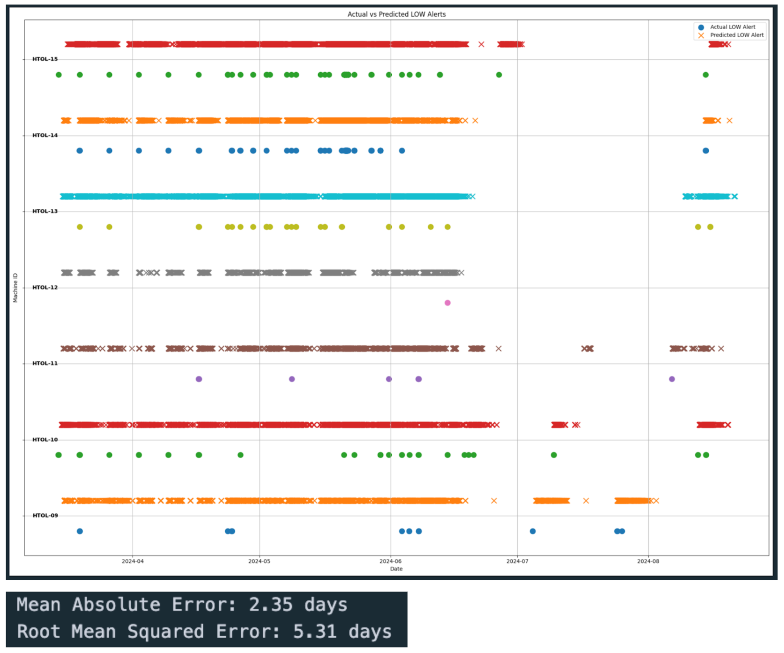
Regression Model
Model Results Visualisations
(LOW Alerts)
MAE of 2 days means our predictions are, on average, off by 2 days.

Slide 6
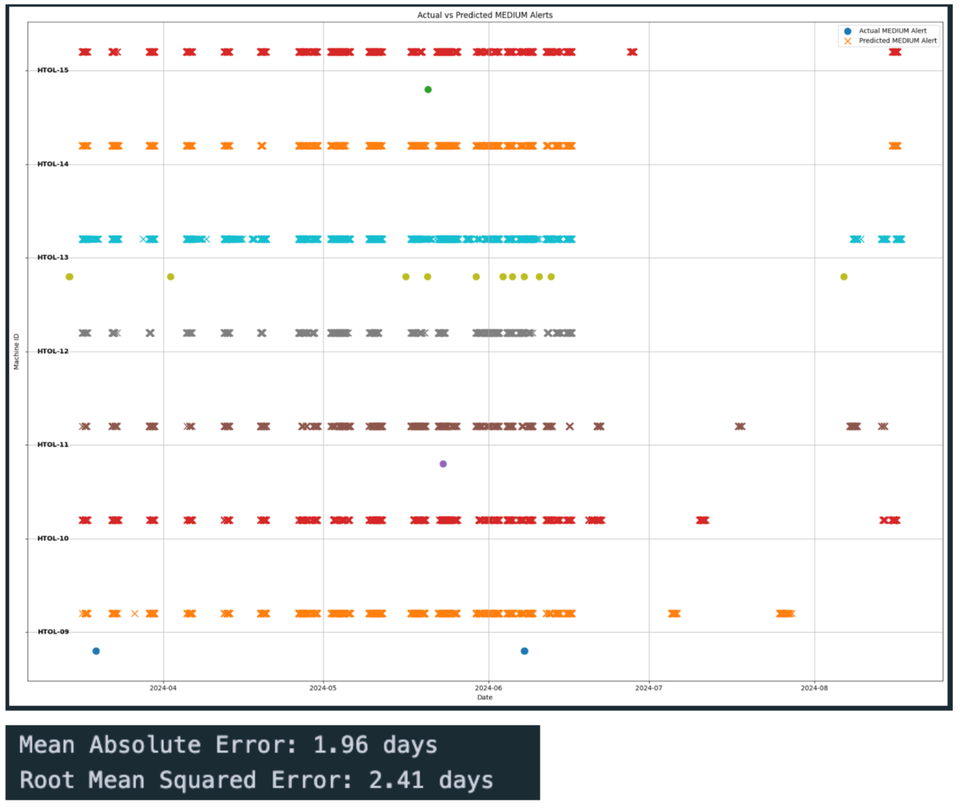
Regression Model
Model Results Visualisations
(MEDIUM Alerts)
MAE of 2 days means our predictions are, on average, off by 2 days.

Slide 7
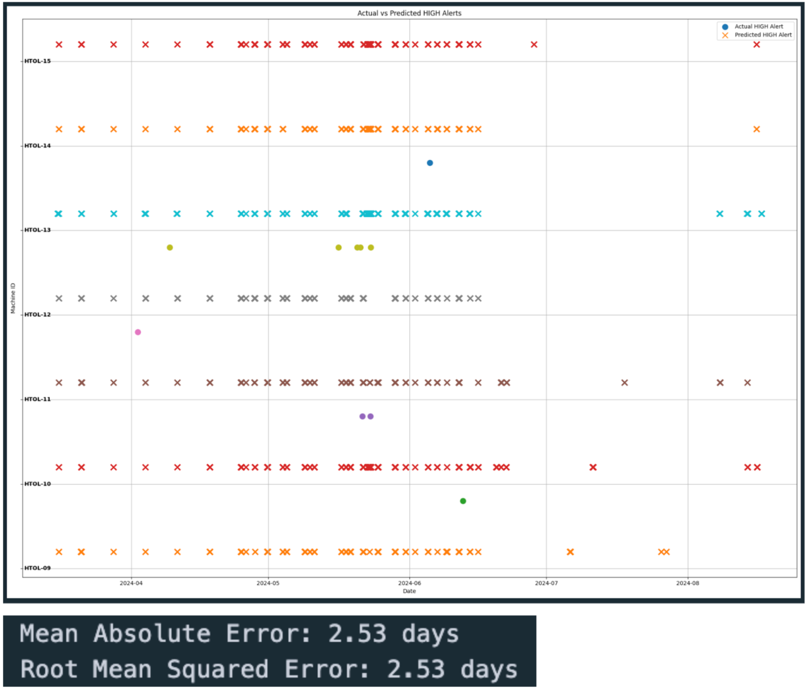
Regression Model
Model Results Visualisations
(HIGH Alerts)
MAE of 2 days means our predictions are, on average, off by 2 days.

Slide 8
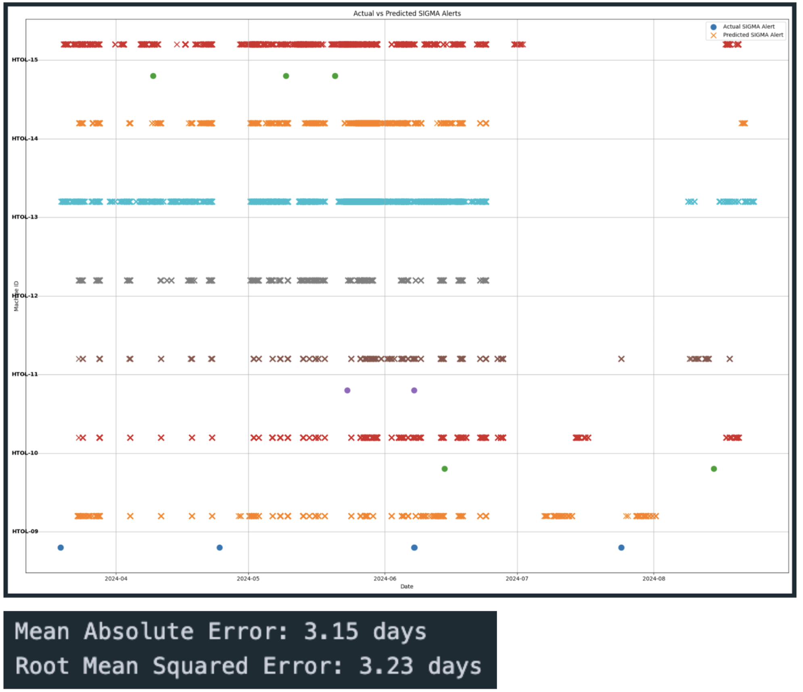
Regression Model
Model Results Visualisations
(SIGMA Alerts)
MAE of 2 days means our predictions are, on average, off by 2 days.

Slide 9
Classification Model
The Classification Model is formulated in such a way that: it predicts the risk of different alert types (LOW, MEDIUM, HIGH, SIGMA) for the HTOL machines. As the training data, we’re using the alerts we have labelled automatically using the Alerting Dashboard previously.
How the Model Works:
Data Preparation:
We take historical data from your machines (HTOL-09 to HTOL-15), including timestamps and ChlPrs values.
We add features like hour of the day, day of the week, and rolling averages of ChlPrs to help the model identify patterns.
Importantly, we use your existing alert data (generated from thresholds and spike detection) to label periods where alerts occurred. This is what the model learns from.

Slide 10
Classification Model
How the Model Works:
Model Training:
We use a machine learning algorithm called a Random Forest Classifier.
The model learns the relationships between the features (e.g., time of day, ChlPrs trends) and the occurrence of alerts.
Prediction:
For a given machine and time, the model predicts the probability of each alert type occurring within the next 7 days.
If this probability exceeds a threshold (e.g., 0.7), we flag it as a "high-risk" period.

Slide 11
Classification Model
Interpreting the Results
Classification Report: The table shows how well the model predicts each alert type.
Precision: Of the alerts predicted, how many were actually real? Higher is better.
Recall: Of the actual alerts, how many did the model catch? Higher is better.
F1-score: A balance between precision and recall.
Visualization:
The plots show actual alerts (blue circles) and predicted high-risk periods (orange crosses) over time for each machine. Good alignment means the model is working well.
Probability Predictions:
For new data, the model outputs the probability of each alert type. Higher probability means higher risk.

Slide 12
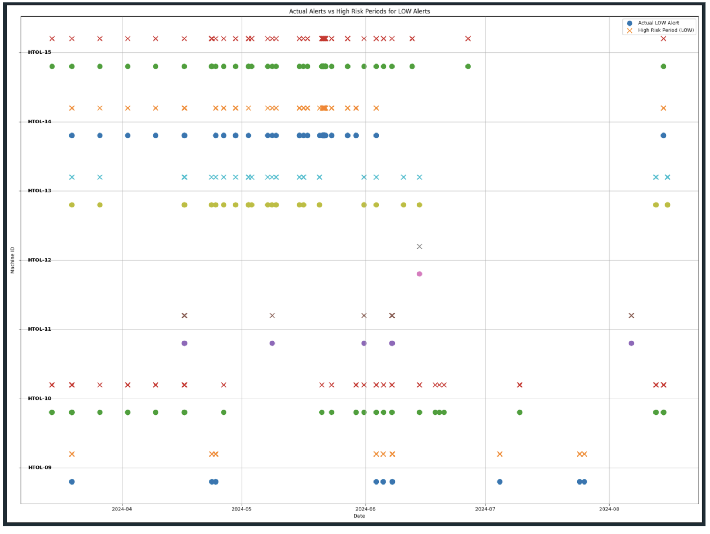
Classification Model
Model Results Visualisations
(LOW Alerts) (Train Data)
Precision: Of the alerts predicted, how many were actually real? Higher is better.
Recall: Of the actual alerts, how many did the model catch? Higher is better.
Precision = 0.97
Recall = 0.72

Slide 13
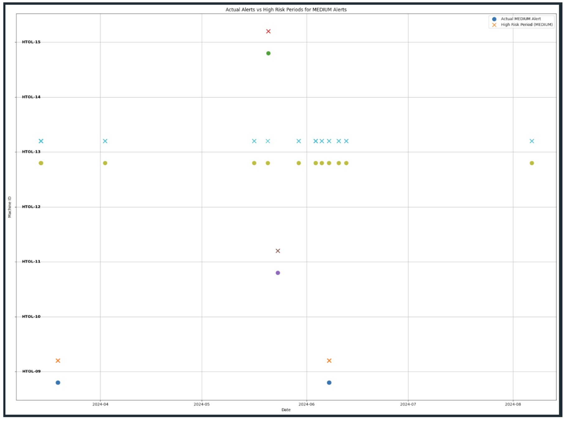
Classification Model
Model Results Visualisations
(MEDIUM Alerts) (Train Data)
Precision: Of the alerts predicted, how many were actually real? Higher is better.
Recall: Of the actual alerts, how many did the model catch? Higher is better.
Precision = 0.98
Recall = 0.78

Slide 14
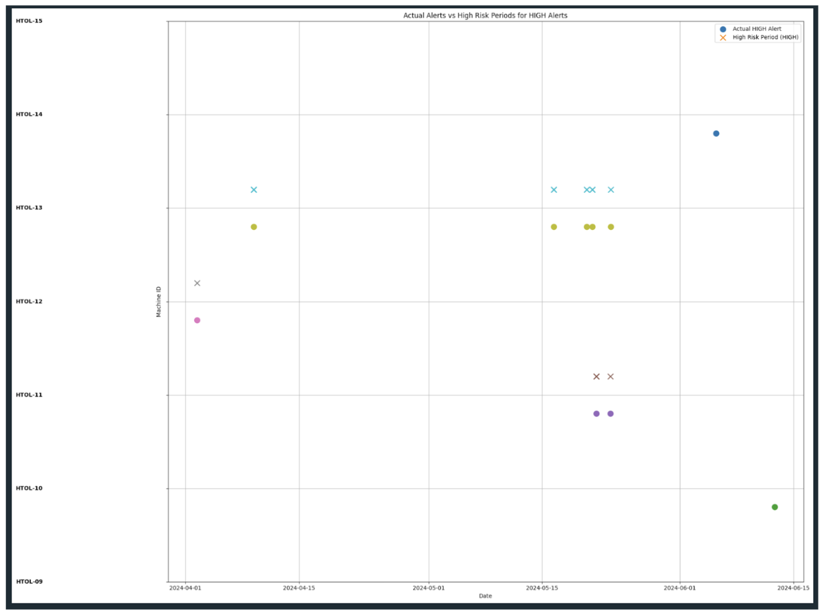
Classification Model
Model Results Visualisations
(HIGH Alerts) (Train Data)
Precision: Of the alerts predicted, how many were actually real? Higher is better.
Recall: Of the actual alerts, how many did the model catch? Higher is better.
Precision = 0.95
Recall = 0.68

Slide 15
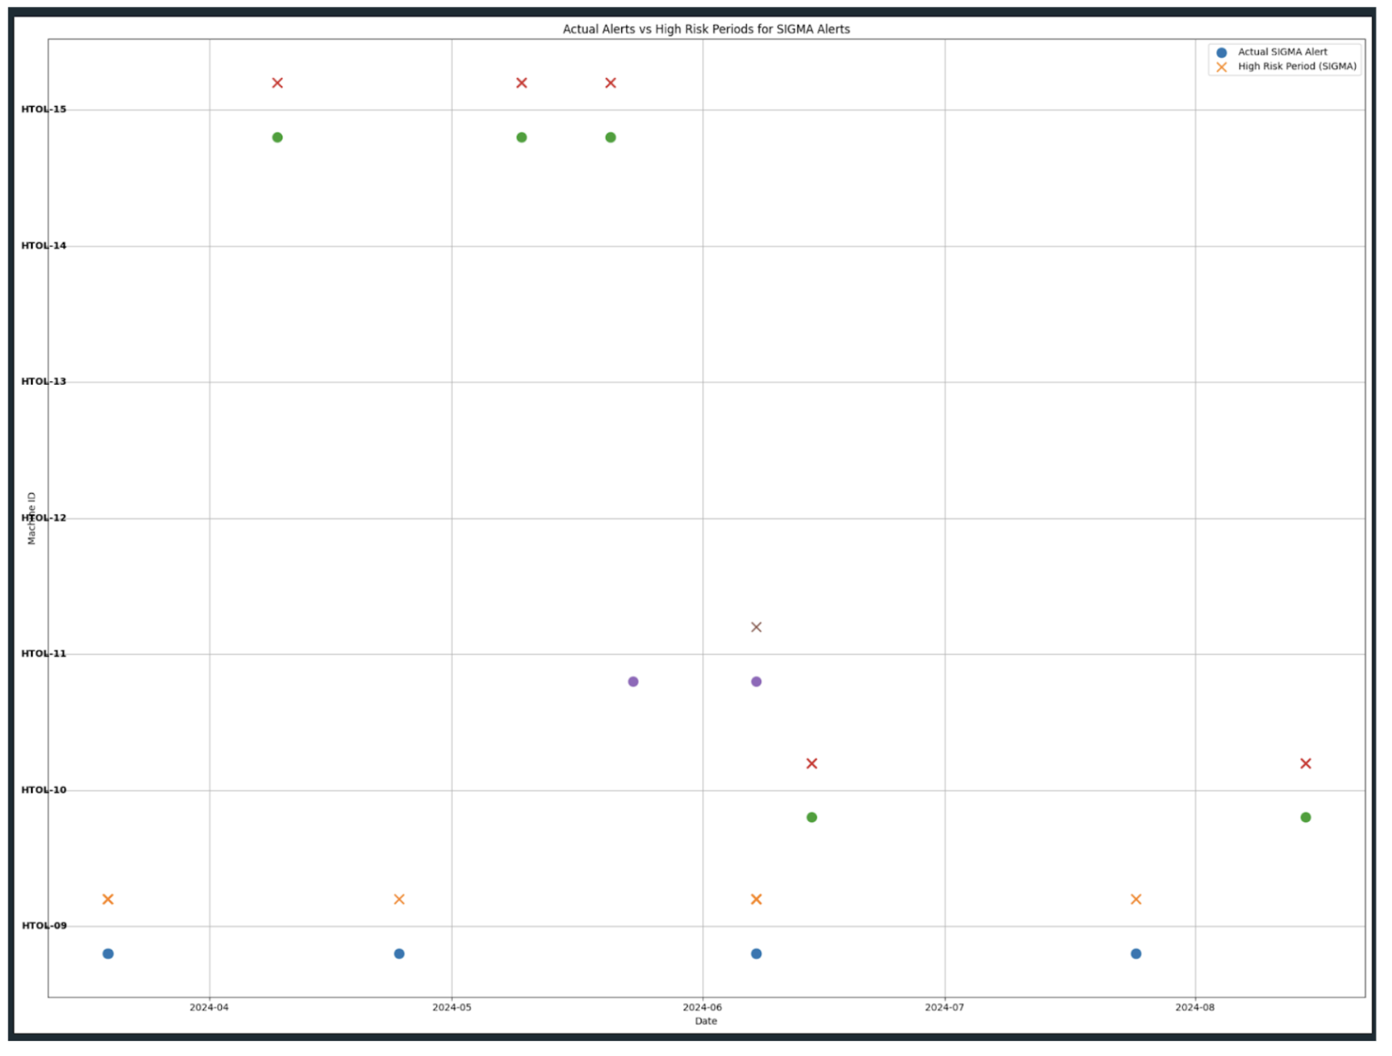
Classification Model
Model Results Visualisations
(SIGMA Alerts) (Train Data)
Precision: Of the alerts predicted, how many were actually real? Higher is better.
Recall: Of the actual alerts, how many did the model catch? Higher is better.
Precision = 0.60
Recall = 0.45

